Slide 1
A Paradigm Shift is Needed in System Control for a Smarter Grid
NIST Roadmap Summit
Dick Brooks
ISO New England
April 28, 2009

Slide 2
Disclaimer
The Smart Grid is still very much a work in process and has not yet reached a consensus understanding. Therefore many assumptions are built into the information provided in this presentation. The ultimate image of the Smart Grid, when it finally solidifies, may or may not resemble the views provided in this document. The opinions of ISO New England expressed in this document are based on the assumptions made and conclusions reached on the current and future state of the Smart Grid.
© 2009 ISO New England Inc.

Slide 3
The lines between Transmission and Distribution are blurring
Increasing number of generating resources located on the distribution network (e.g. wind turbines, solar arrays, microgrids, CHP)
Demand resources playing larger role in traditional “transmission level functions” (e.g. energy, reserves and emergency response)
Regional Power System Control entities need more granular locational and capacity information for both demand and supply resources located on the distribution network
Operable Capacity analysis requires situational awareness of supply resources located within a region, regardless of which network they are connected to
© 2009 ISO New England Inc.

Slide 4
More Choices and Uncertainty - Less time to react
Region wide System Operations and Planning become much more complicated under the Smart Grid
  Choice between using DR Negawatts, traditional generators, distributed generators, variable renewables, imports, Electric Energy Storage to meet the next Megawatt of Load
  Load forecasting is fraught with uncertainty (e.g. impact of EV’s, impact of consumer level generation capabilities such as solar panels)
  Automatic sense/respond devices to consider
  Number, size and location of independently managed Microgrids
  Other factors:
    Renewable Portfolio Standards (RPS)
    Regional Greenhouse Gas Initiatives (RGGI)
    Cost of emissions
    Limited availability of Capital for expansion
    NIMBY
Requires more frequent interaction among system control entities
© 2009 ISO New England Inc.

Slide 5





Smart Grid System Control Entities
LCC’s /TO’s
ISO RTO
LSE’s
Supply
&
Demand
Aggregators
And Microgrids
DISTCO’s
© 2009 ISO New England Inc.

Slide 6
Example of Existing Control Issues
Currently no system-wide coordination/optimization to determine the voltage schedules across ISO NE system
  Could potentially cause unexpected reactive loop flows and voltage violations in real time operation – not operationally efficient
  Lack of coordination between ISO NE and other control entities over voltage schedules, switchable shunts and tap positions of bulk transformers and distribution transformers
No coordinated control and no visibility into small supply resources being installed on the distribution network
  The accumulated capacity of a large number of these resources would have significant impact on ISO planning and system operations if they are not factored into ISO processes up front
  E.g. Saco, Maine wind turbine; Dracut, Mass. Solar PV Array
    http://www.boston.com/news/local/maine/articles/2008/02/06/saco_puts_new_wind_turbine_in_place_of_train_station/
    http://www.istockanalyst.com/article/viewiStockNews/articleid/2943584
  More coordination is needed among controlling entities
© 2009 ISO New England Inc.

Slide 7
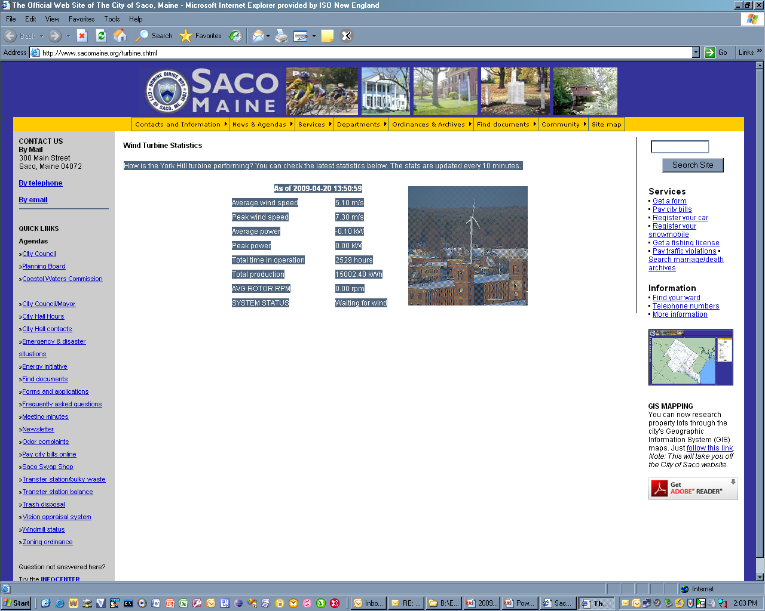
Flood of “Under the Radar” Supply Resources appearing on the Distribution Network
© 2009 ISO New England Inc.

Slide 8
What’s Needed Now
Has been lots of attention focused on standards for end-use interfaces:
  H2G, I2G, B2G
  End use customer visibility of prices and demand response
  Advanced metering
Has been some, but not enough, attention to T&D functions:
  PMU monitoring; Situational Awareness
Virtually NO attention on changes to Power System Control and standards/protocols needed for control functions among System Control entities, e.g.:
  ISO Utilities
  ISO Aggregators
  ISO Other Control Areas
© 2009 ISO New England Inc.

Slide 9
A Paradigm Shift in Power System Control is REQUIRED for the Smart Grid to succeed
Power System Control functions will be significantly impacted by the Smart Grid
More granular control of supply and demand is needed
Supply Management (wherever it is located)
Demand Management
Network Management (both transmission and distribution levels)
Markets Management
Integrated Power System Control across the supply chain will require more frequent interaction among controlling entities
Need for coordination among controlling entities under time critical situations will require greater automation between entities
Thus far there has been insufficient attention to standards and protocols for Control functions among controlling entities
NIST/DOE/FERC should prioritize architecture design work and standards for System Control functions among controlling entities
© 2009 ISO New England Inc.

Slide 10
Smart Grid System Control Requirements
Planning (supply, demand and entire delivery network)
System Operations
  Network Management
  Supply Management
  Demand Management
Market Management
Administration (e.g. Settlements etc.)
How will DISTCOs,LSEs, TO’s, LCC’s, ISO/RTOs share Power System Control responsibilities and interact/interface in the Smart Grid?
The answer will determine the Architecture and Design of Power System Control within the Smart Grid and enable the identification of standards and protocols needed
Architectural Design, Standards and Protocols for Power System Control among system control entities need to become a top priority
© 2009 ISO New England Inc.

Slide 11
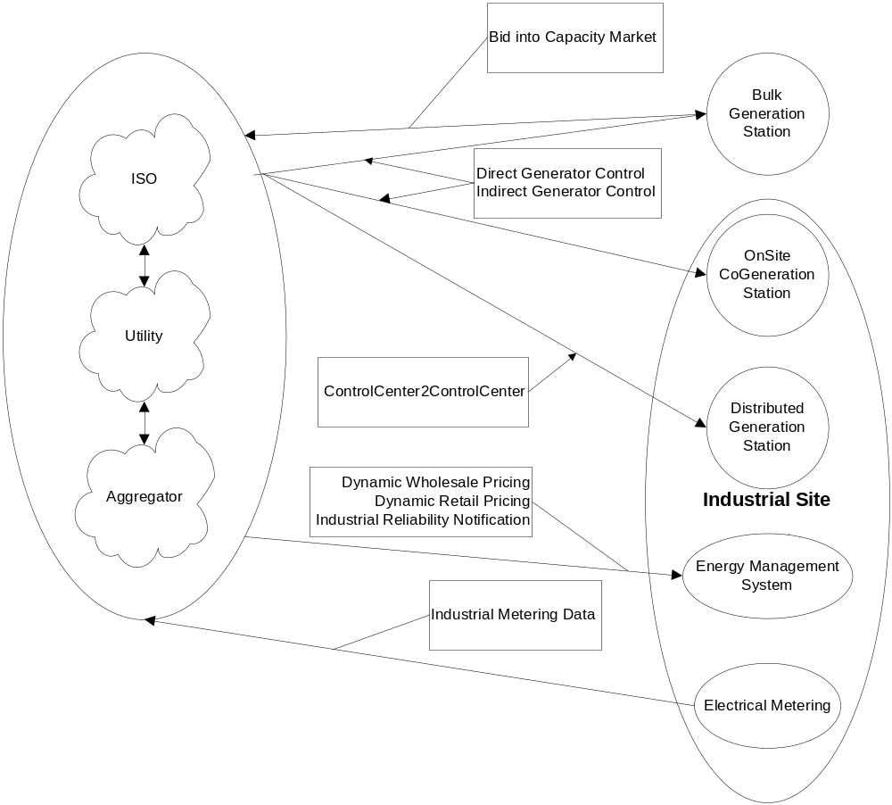
Example:NIST I2G Interactions
Current Standards workgroups “view” control as
a single cloud with multiple entities
Source: NIST I2G Draft Roadmap V 0.5 dated 4/9/2009
© 2009 ISO New England Inc.

Slide 12
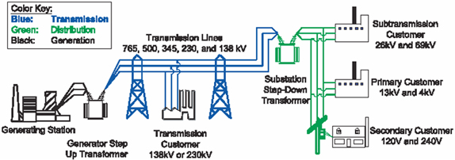
A Paradigm Shift in System Control
Conventional Governance
Smart Grid Governance
Markets
System Control
Supply Resources
Demand Entities
Delivery Network
Source: DOE, http://www.oe.energy.gov/information_center/electricity101.htm
© 2009 ISO New England Inc.

Slide 13
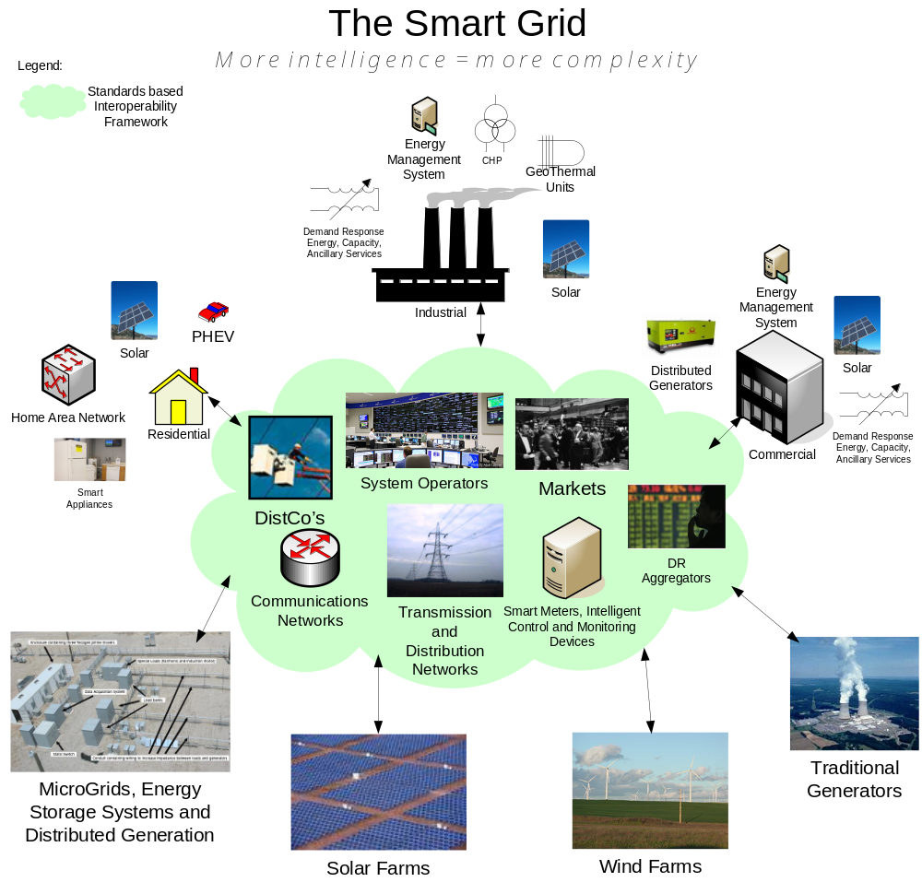
Standards are also
needed among
Controlling Entities
© 2009 ISO New England Inc.

Slide 14
Recommendations
Smart Grid design and implementation must start with Power System Control as a first priority
The rollout of Smart devices should be coordinated with the implementation a Smart Grid Control infrastructure
Request that NIST prioritize the development of Smart Grid architecture, standards and protocols for Power System Control among Controlling entities
Supplement the NIST National Smart Grid Interoperability Coordinator (Dr. Arnold) with Regional Smart Grid Coordinators to ensure that all Smart Grid projects are aligned/harmonized
Develop a set of Smart Grid implementation guidelines that describe how to systematically implement a Smart Grid within a Control Area and between Control Areas
Ensure that new Smart Grid standards do not conflict with existing Energy industry Standards and Standards Bodies (e.g. NERC, NAESB, etc.) are fully leveraged and harmonized with Smart Grid standard developments that are under NISTs control
© 2009 ISO New England Inc.

Slide 15
Conclusions
New Challenges and Technology require new look at the future of System Operations, Planning and Markets
Many changes must take place without negative impact to customers and overall grid performance
Both Operations and Planning will have to change to accommodate new Grid and Decentralized Control among multiple control entities
Interoperability at all levels – from regulatory to computer and communication systems is a key to success of new grid
Public pressure spawned by the Stimulus package is requiring ISO’s to implement what’s available now – can’t wait for standards to emerge
Professional management of the standards-making process is a critical element of ensuring an efficient Smart Grid deployment
© 2009 ISO New England Inc.

